Slide 1
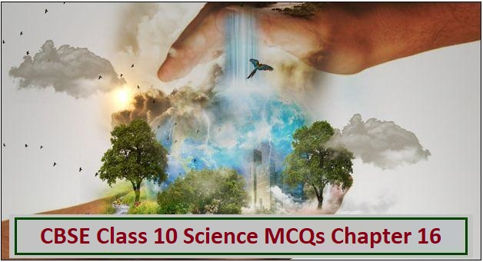
Class X Chapter 16
Management of
Natural Resources.
Module 2/2

Slide 2
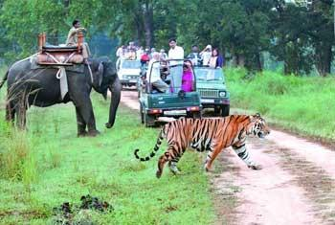
WILDLIFE CONSERVATION

Slide 3
ASK YOURSELF
Don’t all beings on earth have the right to live like ME?

Slide 4
Conservation can be done by following methods-
Maintenance of wildlife in protected areas:
it is done by maintaining the following-
National parks- a protected area where cultivation, grazing, hunting, etc. are not allowed.
For example- Jim Corbett National Park.
Sanctuaries- They are the protected areas where hunting is not allowed but all other activities are allowed.

Slide 5
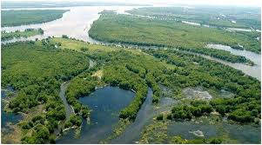
Biosphere reserve-
A protected area meant for conservation of wildlife, traditional lifestyle of tribals and their domesticated animals.
Protection of their natural habitat.

Slide 6
PROTECTION THROUGH LEGISLATION
There are a number of wildlife acts like IBWL ( Indian board of wildlife), 1952.
Wildlife Protection Act, 1972.
MAB ( Man And Biosphere
Programme), 1971.
CITES (Convention Of International Trade In Endangered Species),1976.

Slide 7
Water for all
Water is required for fulfilling the basic needs of
individuals.
Human activities have altered the availability of water in various regions.
Rain in India are due to monsoon. Common irrigation methods such as dams, canals and tanks are used in various parts of India.
These methods are maintained by local people. This helps in storing water which can be used in agriculture.
Not only in agriculture, daily needs of the common people can be met through this water.

Slide 8
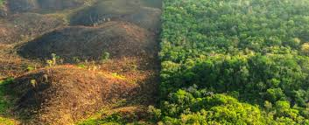
Reason due to which we fail to sustain under ground water availability are as follows-
Loss of vegetation cover.
Diversion for high water demanding
crops.

Slide 9
Pollution from industrial effluents and urban waste. Irrigation methods like dams, tanks and canals.

Slide 10
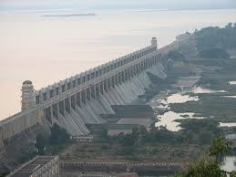
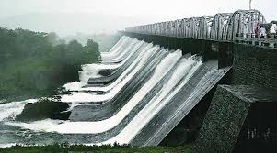
DAMS
Dams are large water bodies that are built by government agencies across the rivers to regulate the flow of water and generate electricity.

Slide 11
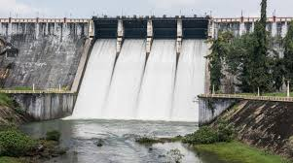
THE ADVANTAGES OF DAMS ARE AS FOLLOWS-
They ensure adequate amount of water for irrigation through a canal.
Water in dams is used for generating electricity.
They ensure uninterrupted water supply.

Slide 12
Ancient Method of Watershed Management System
Different methods of watershed management system are known since ancient times.
One of the method known as Khadins in Rajasthan which consists of a long earthen embankment built across the lower hill slopes.
The area enclosed by the embankment is called as ‘bund’ which collects huge amount of rainwater which flows down the slopes.
Subsequently this water saturated land is used for crop production.

Slide 13
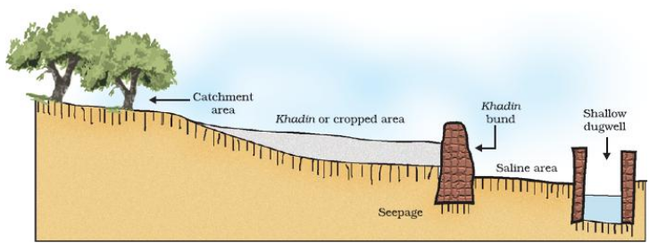
KHADIN SYSTEM An ancient method of watershed management.

Slide 14
TALABS are other mode of watershed management system known so far. It stores water for drinking and household consumption purposes. Others include KULHS in Himachal Pradesh, AHAR and PYNES in Bihar, ERIS in Tamil Nadu, BUNDHIS in Madhya Pradesh, SURANGAMS in Kerala etc.

Slide 15
Coal and petroleum
They are the non-renewable natural resources.
Coal is formed by the remains of the trees buried inside the earth.
Petroleum is formed by the bacterial decomposition of dead plants and dead animals. High pressure and temperature are needed for the formation of petroleum.

Slide 16
Both coal and petroleum are fossil fuels. They are getting used up at higher rate, so there are more chances that they get exhausted soon.

Slide 17
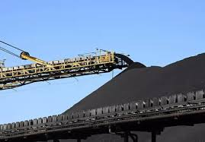
Both coal and petroleum are fossil fuels. They are getting used up at higher rate, so there are more chances that they get exhausted soon.
They both form fossil fuels and as we know that they require much time to get replenished, so their judicious use is recommended in order to save them for future generations.

Slide 18
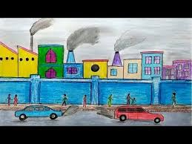
Disadvantages of Fossil Fuels -
Burning of fossil fuels release large amount of carbon-dioxide, sulphur dioxide and other harmful gases. This causes air pollutions and the harmful effects of air pollution. This also raises the earth temperature and thus leads to global warming.

Slide 19
Steps to minimize the pollution from Fossil Fuels Reduce the use and burning of fossil fuels. Use of CNG in transport vehicles to reduce pollution. .

Slide 20
Alternative sources of energy such as Hydroelectricity, nuclear, solar, wind power and biogas should be used.

Slide 21
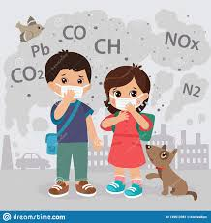
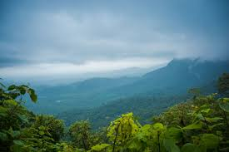
LET US BE THE CHANGE TO BRING A CHANGE Thank you M. Varalakshmi TGT AECS , Anupuram.

